Slide 1
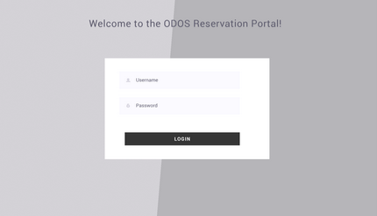
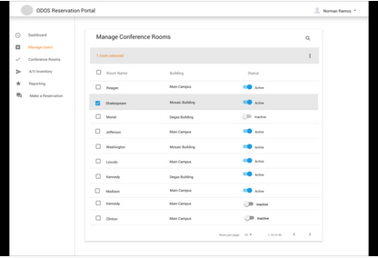
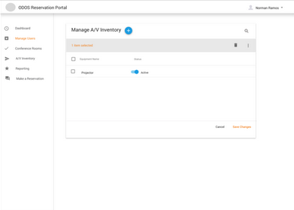
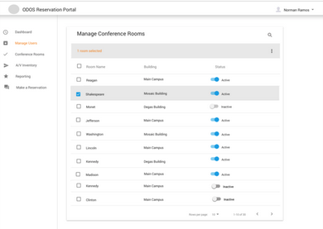
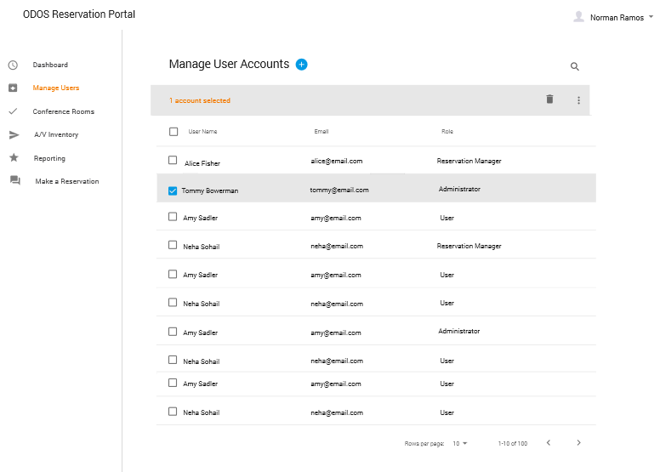
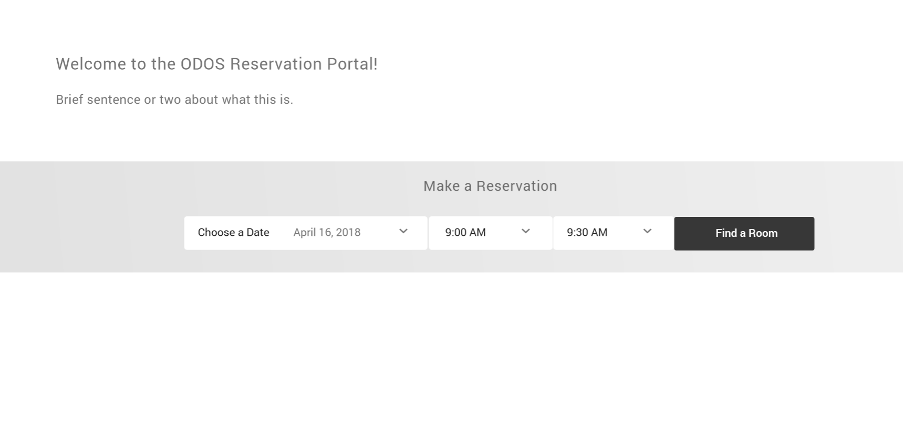
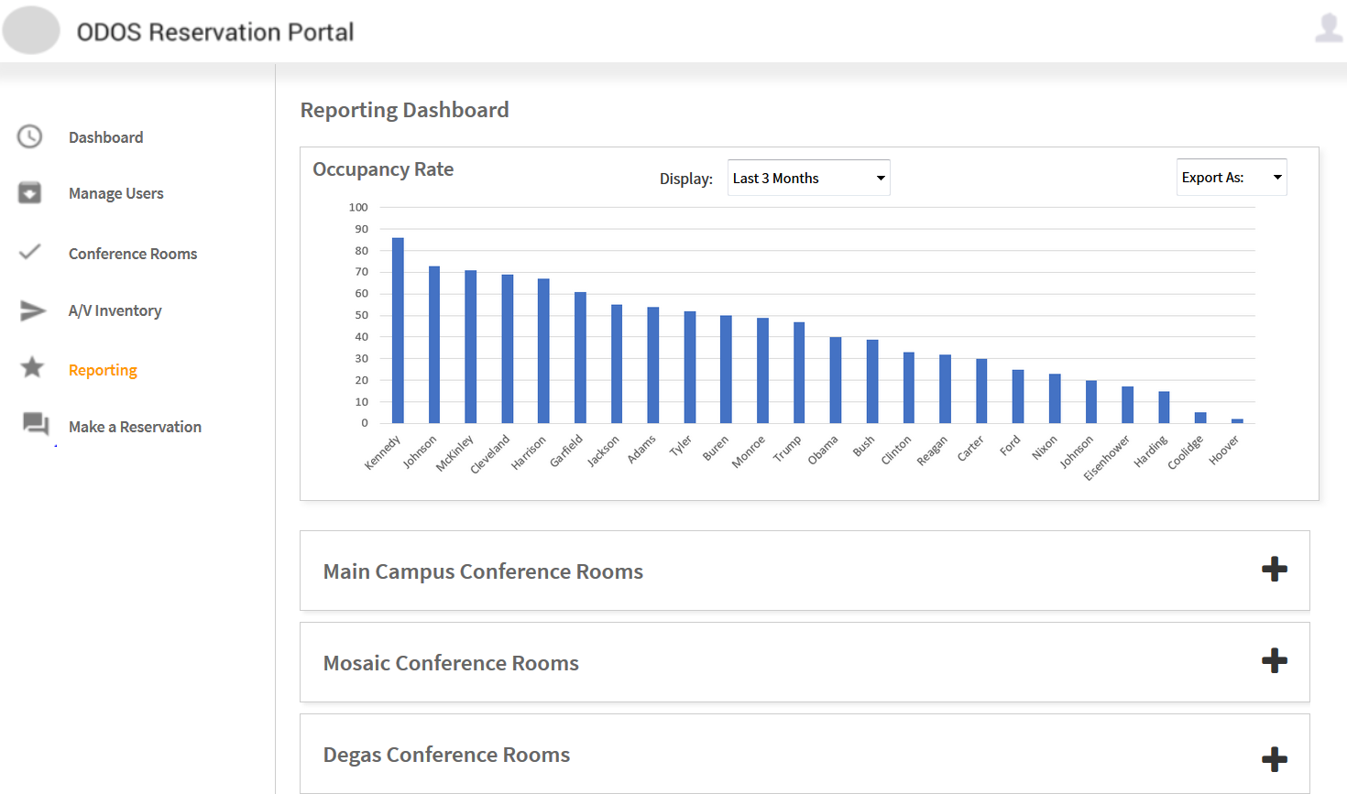
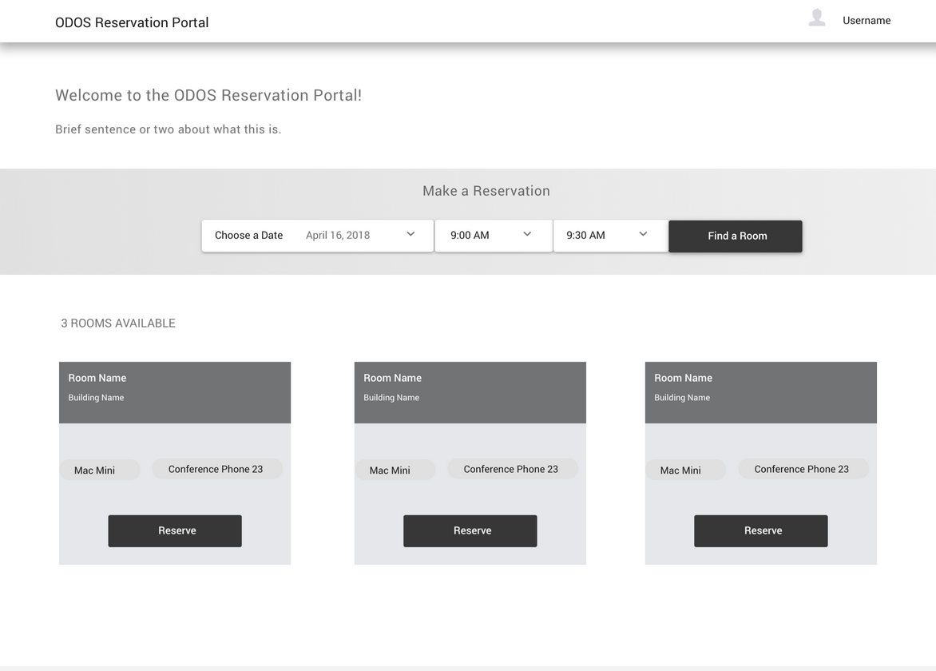
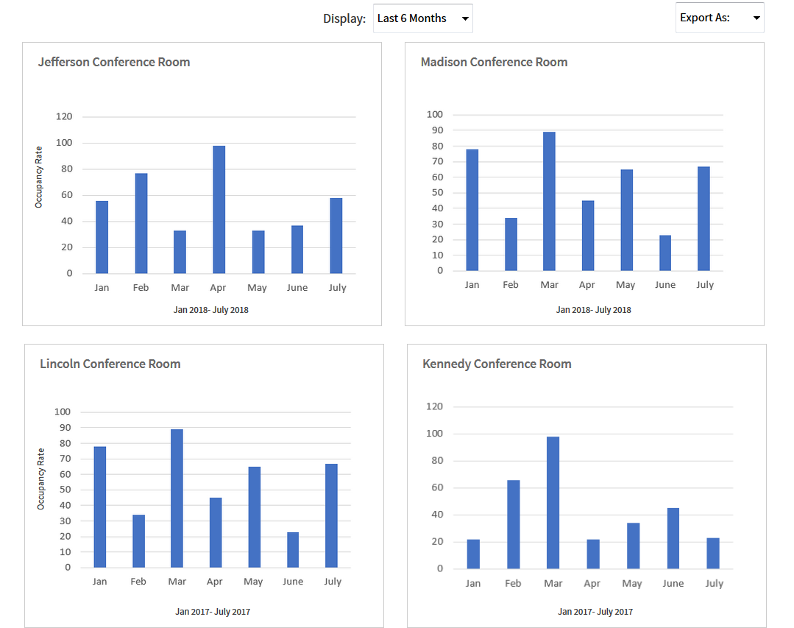
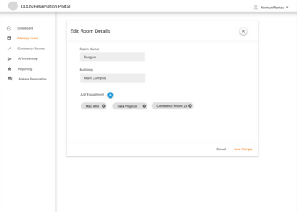
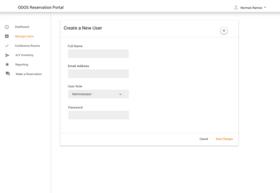

Conference Room Web Application
Administrator
Administrator
Login
Admin Dashboard
Manage A/V Inventory List
Manage Conference Rooms
Manage User Accounts
Make a Reservation
Report Dashboard
Edit Room Status
Create/Edit/Delete User
Book Room
View/Export Reports

Slide 2
Conference Room Web Application
Login
Reservation Manager
Make a Reservation
Report Dashboard
Find Available Rooms
View/Export Reports
Book Room

Slide 3
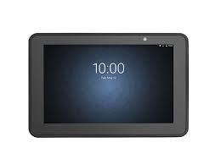
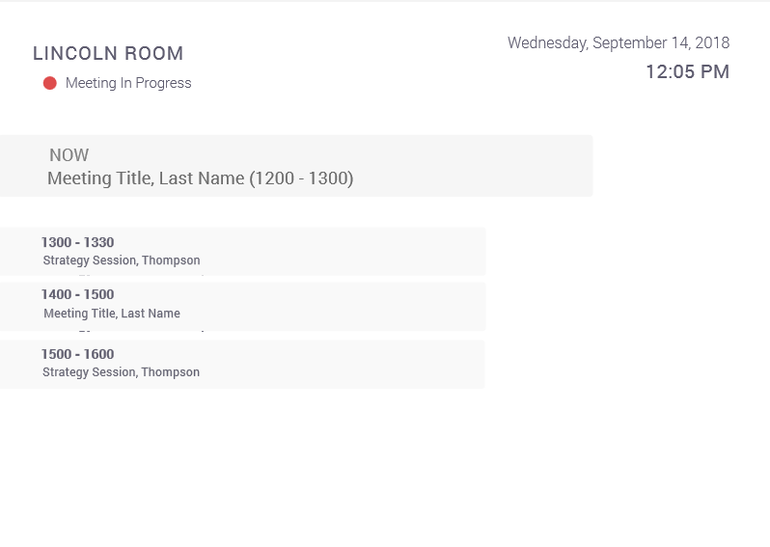
Conference Room Web Application
Requester User
Login
Display Panel
Make a Reservation
Conference Room Schedule
Find Available Rooms
Book Room

